Slide 1

Normalization
Exercise

Slide 2
Next Quiz Will Cover:
ER DIAGRAMS
RELATIONAL SCHEMA NORMALIZATION

Slide 3
Check List:
Identify all the entities and related attributes (Make sure you recognize weak entities as well)
Identifying all the relationships (Make sure you found relationship attributes if any)
Write your assumptions (If any)
Now draw your initial ER diagram
Now identify Participation, Connectivity and Carnality constraints (if any)
Confirm whether you have identified identifying relationships (if any)
Cross examine your ER reading and reading the given description.
Confirm whether you have correctly specified Participation, Connectivity and Carnality constraints. (Use the trick I taught during the class)

Slide 4
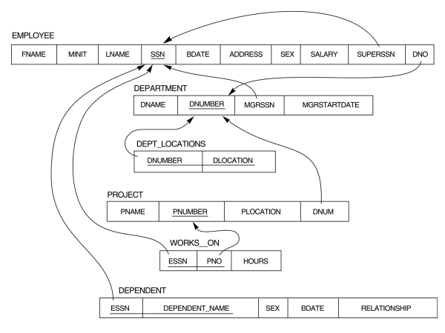

Slide 5
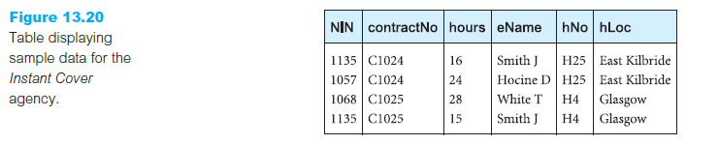
Question
An agency called Instant Cover supplies part-time/temporary staff to hotels within Scotland. The table shown in Figure displays sample data, which lists the time spent by agency staff working at various hotels. In the Work_details table the National Insurance Number (NIN) is unique for every member of staff. State any assumptions if any.

Slide 6
Identify the current normal form which ‘contract’ table belongs to.
What is the primary key of this table?
Identify all the functional dependencies.
Normalize the contract table to its highest normal form

Slide 7
Identify the current normal form which ‘contract’ table belongs to.

Slide 8
Assuming the employee names and hotel locations (hLoc) are atomic, the table below is in 1NF as not having lists, arrays or repeated groups of data.
Work_details(NIN, contractno, hours, eName, hNo, hLoc)

Slide 9
2) What is the primary key of this table?

Slide 10
Work_details(NIN, contractno, hours, eName, hNo, hLoc)

Slide 11
3) Identify all the functional dependencies.

Slide 12
NIN → eName
contractNo → hNo
hNo → hLoc
NIN + contractNo → hours

Slide 13
Choosing the NIN + contractNo as the primary key the FD’s become,
NIN → eName (partial dependency)
hNo → hLoc (transitive dependency)
contractNo → hNo (partial dependency)
NIN + contractNo → hours (primary key dependency)

Slide 14
4) Normalize the contract table to its highest normal form.

Slide 15
By decomposition the two partial dependencies can be removed and the resulting 2NF tables are,
Employees (NIN, eName)
Contracts( contractNo, hNo, hLoc)
Work_details(NIN, contractNo, hours)

Slide 16
By removing the transitive dependency in Contracts table, the 3NF database is,
Employees (NIN, eName)
Contracts( contractNo, hNo)
Hotels(hNo, hLoc)
Work_details(NIN, contractNo, hours)

